Slide 1
Welcome To Our Presentation on
Real Time Covid-19 Tracker

Slide 2
Present By
PRESENT TO
Name | ID
Md. Mahedi Hasan | 17182103278
MD. Hasibur Rahman | 17182103280
Tahmid Ahmed | 17182103311
Md. Aminul Islam | 17182103319
Alhaj Hossen | 17182103335
Md Mamunur Rashid Lecturer Department Of Computer Science &Engineering

Slide 3

Introduction

Slide 4

Development Tools
Android Mobile Based Application
Programming Language : XML,JAVA

Slide 5

System Features
Update information of world-wide
Update information of home country
Instant update data
All countries update data available

Slide 6
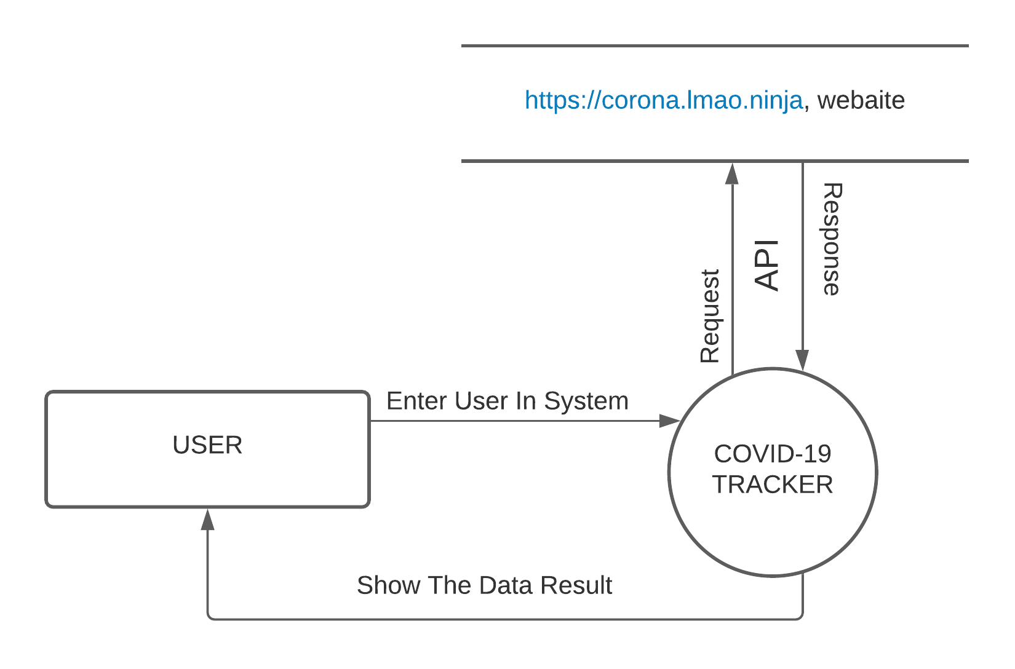
Context Level DFD

Slide 7
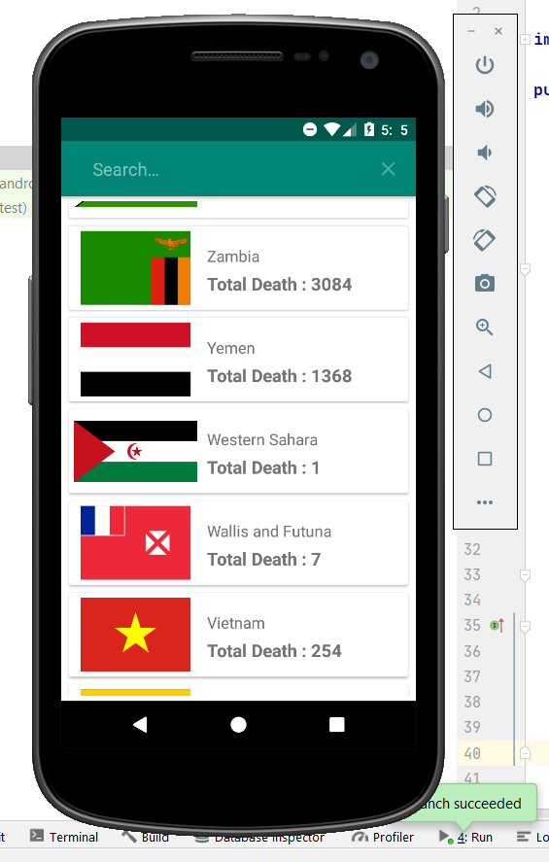
Splash Screen

Slide 8
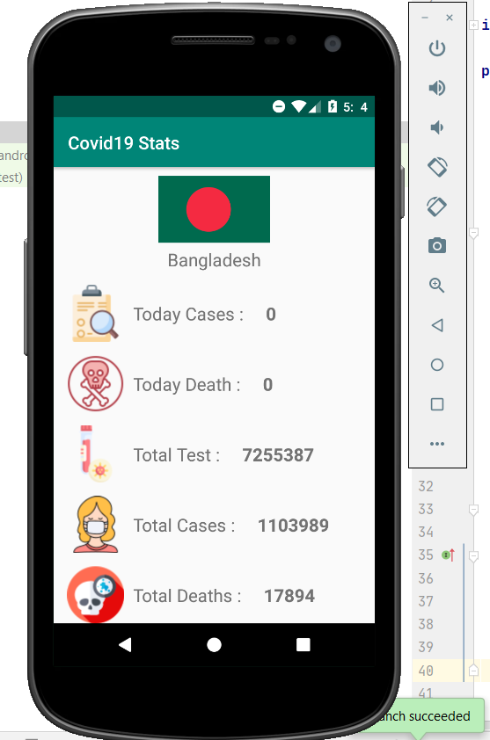
Home Country
Will be know about corona update information in Home Country.
Will be know about the total number of people today cases, the total number of people today deaths, the total number of people tests, the total number of people total case, the total number of people death total deaths , total number of people recovery.

Slide 9
All Countries
View the all countries corona update information
Facility of the search option

Slide 10
Future Work
Multiple language support
User authentication method
Using firebase database
Corona help center facility

Slide 11
Motivation
Easy to get corona updates information
Will be able to know about the corona update of home country
Will be able to know about the corona update of all world country
Will be know how many affected or deaths

Slide 12
Conclusion
By using this app, we will be able to know the constant updates of Corona of all countries of the world including our own country from the our own house.
The main purpose of this project is to raise public awareness about corona symptoms and to update corona regularly.

Slide 13
Thank You

